Slide 1

Zen Data Shastra
Mock Project
Findings and Solution
September 23, 2024
Reach out to us at contact@zendatashastra.com | +91- 898-212-0281
This document and its attachments are confidential. Any unauthorized sharing, copying or disclosure of any material is strictly forbidden

Slide 2

AGENDA
1
Executive Summary
Insights: Findings and Solutions
Recommendations
Questions?
2
3
4

Slide 3
Executive Summary

Slide 4

Executive Summary
What is our Problem Statement?
A retail store aims to increase sales by 5% and improve customer loyalty by understanding drivers of decline and identifying clearly defined targets (for both sales and customer loyalty)
What are we going to do?
Sales per year:
2018 – 18.69 M
2019 – 31. 25 M
2020 – 26.54 M
To Increase by 5%:
Sales: 27.87 M
What is our Project plan?
Data Cleaning
Exploratory Data Analysis(EDA)
Getting Insights and understanding patterns
Proposing Solutions and Recommendations
What do we propose?
Set-up of In-store stores in North-East region, specifically in States with least number of stores
Optimisation of discounts for customers
Bringing Gender Diversity in Sales Team
Decrease the Delivery time

Slide 5
Insight 1
For Increasing of Sales

Slide 6
Findings
Insight:
Solution Proposed:
It was observed that the sales of North-East region was not in relation with population of North-east region.
The no. of stores in the region is less with maximum 20 stores in a state and total of 46 stores in the entire region.
Increase the number of Stores in the states of North-East region where the stores are less compared to other states.
Profits from South and West regions can be utilized to setup new stores in the North-East Regions
Region | No. of Stores
North-East | 46
Mid- West | 78
South | 116
West | 127

Slide 7
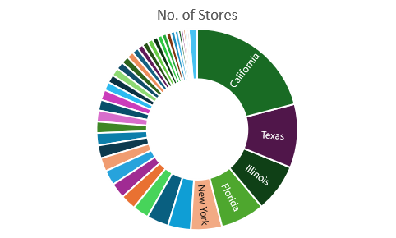
Store Status for Top Revenue generating Regions
In West Region, California has the highest Sales and our insight is, out of 127 stores in West Region, 74 Stores are solely present in California(58.2%).
In South Region, Texas has the highest Sales and our insight is, out of 116 stores in South Region, 38 Stores are present in Texas(32.7%).
16.12 M Sales is from California across the West region where the Sales is 26.90 M.
7.85M Sales is from Texas across the South Region where the sales is 24.56M.
59.9% Sales are from California under West region
31.9% Sales are from Texas under South region

Slide 8
Sales according to NORTH-EAST REGION:
Sales in North-East Region through Online Channel keeps decreasing every year.
2018-2019: 2%
2019-2020: 2%
But Overall Sales in North-East Region is gradually increasing. 2018-2019: 2.8%
2019-2020: 0.5%
Total Sales according to Channels:
We can infer from this, that the population from northeast region prefers in-store channel more compared to other channels.
Hence, in-store channels has higher potential of yielding more revenue.

Slide 9
Insight 2
For Increasing of Customer Loyalty

Slide 10
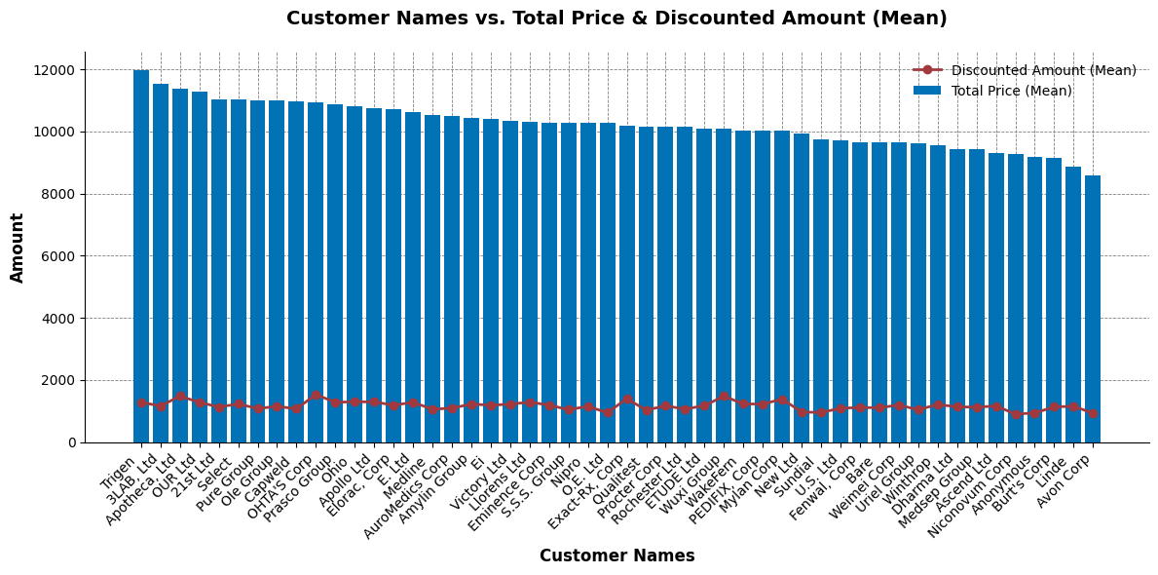
Findings
Insights:
The average discount applied on customers’ purchases irrespective of the Sales contributing to the company is same for all customers.
Solution proposed:
Identification of customers yielding higher revenue to the company and optimising discounts for them.

Slide 11
Recommendations

Slide 12
Male and Female Staff Metrics
Insight:
The Sales in those Stores where there were Females in the teams, had higher sales on an average in comparison to stores with Male teams.
Recommendation:
Increasing Gender Diversity by including female staffs in various stores
Average Sales over 3 years of time:
Male teams: 2.71 M
Female teams: 2.81 M
- Male
- Female

Slide 13
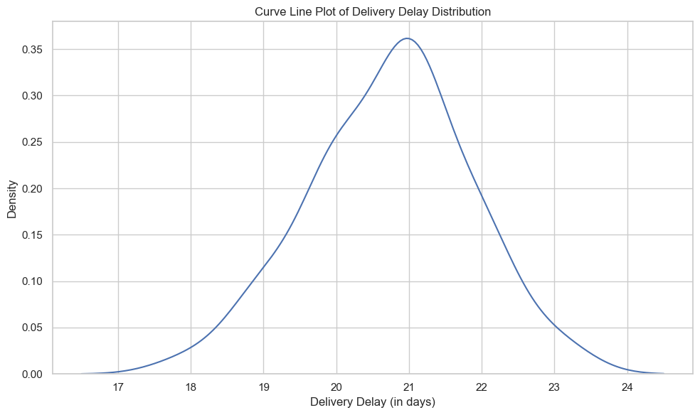
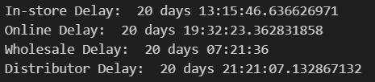
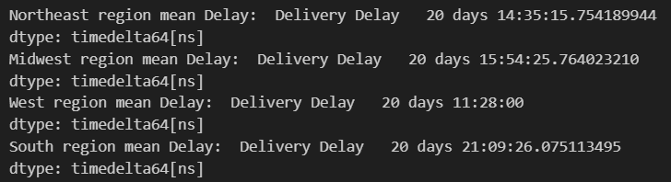
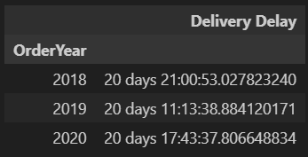
Order and Delivery Demographics
Insights:
The Delivery Delay is approximately 21 days for all channels across all regions and has been the same throughout the years.
Recommendation:
Reduce the duration of delivery in order to ensure customer satisfaction and loyalty.

Slide 14
Questions?

Slide 15
Thank You
Reach out to us at contact@zendatashastra.com | +91- 898-212-0281
This document and its attachments are confidential. Any unauthorized sharing, copying or disclosure of any material is strictly forbidden

